Slide 1

One-Way Analysis of Variance
(ANOVA)
Dr Lee Barnby
School of Computing
7MA505 Statistical Techniques
Week 4, Autumn Semester

Slide 2
Outline
One-way analysis of variance
  Popularly known as ANOVA
  Comparing the means of three or more different groups
  Extension of the t-test for three or more samples

Slide 3
Analysis of Variance: Assumptions
The samples are independent random samples
  Think about how the data were collected
The samples are taken from normally distributed populations
  You could test this with the Q-Q plot etc.
The samples are taken from populations with the same variance
  There are tests for this e.g. Bartlett test http://www.itl.nist.gov/div898/handbook/eda/section3/eda357.htm
  also provided in R with bartlett.test function
Analysis of variance tests for H₀: µ₁ = µ₂ = µ₃ = µ₄ = …

Slide 4
ANOVA conceptually
The hypothesis test is based on splitting the variation in the data into
  Variation within each sample
  Variation between the samples
Variation in data = variation within groups + variation between groups
  Variation in data – total variation around overall mean
  Variation within groups – variation in a group around the sample mean
  Variation between groups – variation between the sample means

Slide 5
Example question and data
Length of stay (hours) in hospital for patients having same procedure in different hospitals
Are there differences in the length of stay between hospitals?
Hospital A | Hospital B | Hospital C
100 | 120 | 130
134 | 154 | 160
132 | 152 | 161
125 | 150 | 157
121 | 141 | 151
144 | 161 | 170
110 | 131 | 140
133 | 160 | 165
113 | 132 | 142
145 | 154 | 162

Slide 6
ANOVA continued
The analysis of variance test can be presented in an ANOVA table using the variation, or ‘sums of squares’, values
  SST – total sum of squares
  SSW – sum of squares ‘within’
  SSB – sum of squares ‘between’
  SST = SSW + SSB
The test statistic is called the F-test
  After R. Fisher who developed it
It compares the two types of variation, between and within

Slide 7
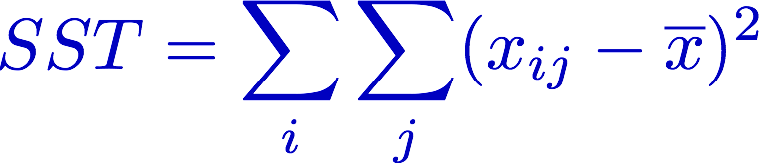
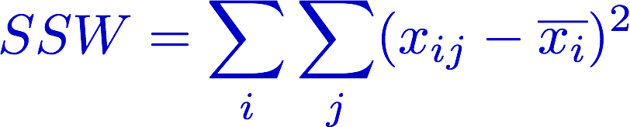
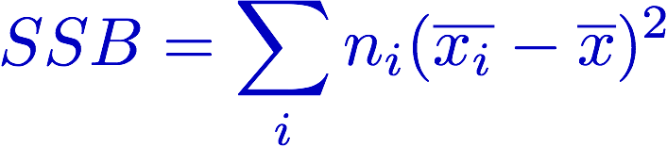
Definitions – sums of squares
Sum of square total
Sum of squares within
group
Sum of squares between
groups

Slide 8
Definitions cont. – Degrees of freedom
For n total observations in i groups the total degrees of freedom is n-1
  i.e total number of observations minus 1
For the SSW term there are n-i degrees of freedom
  Since terms are consider group-by-group and 1 d.o.f. is subtracted for each
For the SSB term there are i-1 degrees of freedom
  Since in this term there are i group means to consider, minus 1
NB degrees of freedom are consistent
  (n-i) + (i-1) = n -1

Slide 9
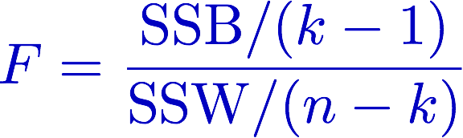
Definition – F-statistic
Named for biologist and statistician Ronald A. Fisher
Defined thus:
Takes 2 degree of freedom parameters
Large values indicate that contribution to variance between groups is comparatively large, and so null hypothesis is unlikely
But how unlikely? Look at F distribution

Slide 10
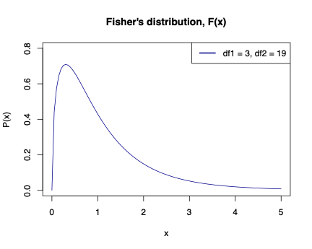
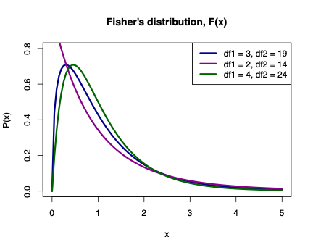
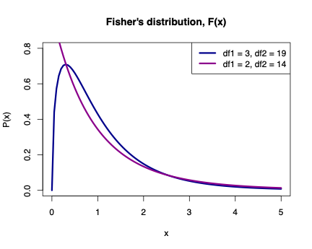
Fisher’s F distribution

Slide 11
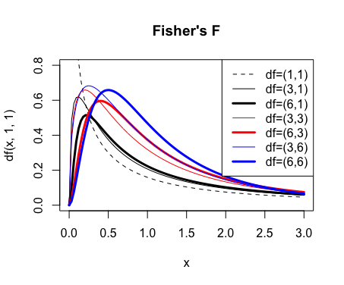
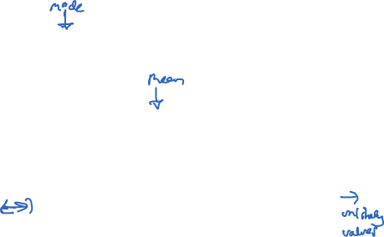
Fisher’s F distribution
Distribution has long tail to the right
From R:
curve(df(x,1,1), xlim=c(0,3), ylim=c(0,.8), lty=2)

Slide 12
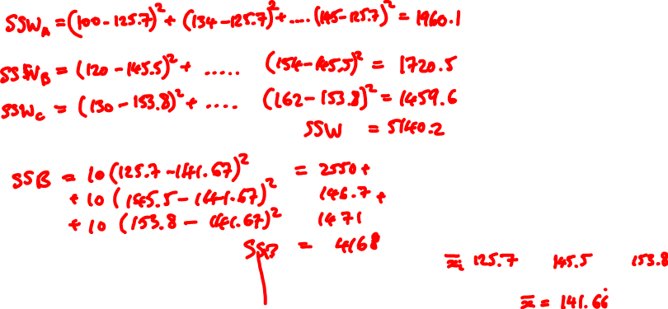
Let’s do the example
Hospital A | Hospital B | Hospital C
100 | 120 | 130
134 | 154 | 160
132 | 152 | 161
125 | 150 | 157
121 | 141 | 151
144 | 161 | 170
110 | 131 | 140
133 | 160 | 165
113 | 132 | 142
145 | 154 | 162

Slide 13
Example cont.
Calculated values
SSB = 4168
SSW = 5140
F = SSB/ d.o.f
SSW/d.o.f
Degrees of freedom:
Numerator k - 1 = 2
Denominator n - k = 27
Use pf() function to get the probability for your value of F
pf(10.73,2,27) gives 0.9996
1-0.9996 = 4 x 10⁻⁴, so very small p value
See also nice Khan academy video:
https://www.khanacademy.org/math/statistics-probability/analysis-of-variance-anova-library
(3 parts, approximately 30 minutes in total)

Slide 14
Hospital example using R
Are the lengths of stay different:
H₀ : µ₁ = µ₂ = µ₃ i.e µ_{a} = µ_{b} = µ_{c}
Input the data:
  A <- c(100,134,132,125,121,144,110,133,113,145)
  B <- c(120,154,152,150,141,161,131,160,132,154)
  C <- c(130,160,161,157,151,170,140,165,142,162)
  hospstay <- cbind( c(A,B,C), c(rep("A",10),rep("B",10), rep("C",10)) )
  hospstay # You will see the data
  colnames(hospstay) <- c("StayLength", "Hospital") # Gives sensible names
Or as a data fame
  HospStay <- data.frame( c(A,B,C), c(rep("A",10), rep("B",10),rep("C",10)) )
  names(HospStay) <- c("StayLength","Hospital")
Repeated on next slide

Slide 15
Hospital example using R cont.
Alternatively, as a data fame
  HospStay <- data.frame( c(A,B,C), c(rep("A",10), rep("B",10),rep("C",10)) )
  names(HospStay) <- c("StayLength","Hospital")
  summary(HospStay) # Summarizes (obviously)
  boxplot(HospStay$StayLength ∼ HospStay$Hospital) # More visual representation
Performing the test (the crucial part!)
  oneway.test(HospStay$StayLength ∼ HospStay$Hospital)
Also Bartlett Test for equal variances
  bartlett.test(HospStay$StayLength ∼ HospStay$Hospital)
  This answers the question is the variability in the lengths of stay the same.
Try also with
var.equal = TRUE
This is the same as the “simple” test we did.

Slide 16
Summary
Use ANOVA to investigate the difference of means for 3 or more groups
  Within R you can use oneway.test() function
  Default test in R is more sophisticated and can sidestep assumption of equal variances
    This behaviour can be turned off for comparisons
  Equal variance assumption can be tested with Bartlett test [bartlett.test()]
If the null hypothesis is rejected it does not immediately tell you which mean is different
  Pairwise t-tests are needed to establish this

